Slide 1

Office Research Integrity & Compliance: Annual Update
Overview of ORIC Activities
Caren J. Frost, PhD, MPH
AVPRIC
January 2024

Slide 2

AGENDA
Re-introduce ORIC units and their services
Describe ORIC’s initiatives
Explore federal/local updates
Highlight upcoming events

Slide 3

ORIC Overview
Mission Statement
Advancing research integrity and compliance through developing, demonstrating, and disseminating innovative processes, tools and outreach that improve scientific outcomes, transparency and accountability through the translational research continuum
Objectives
  Promote research integrity & responsible conduct of research across campus
  Manage compliance in the research landscape by keeping current with university, state, and federal regulations
  Provide policies, rules, and guidance on new federal and state requirements

Slide 4
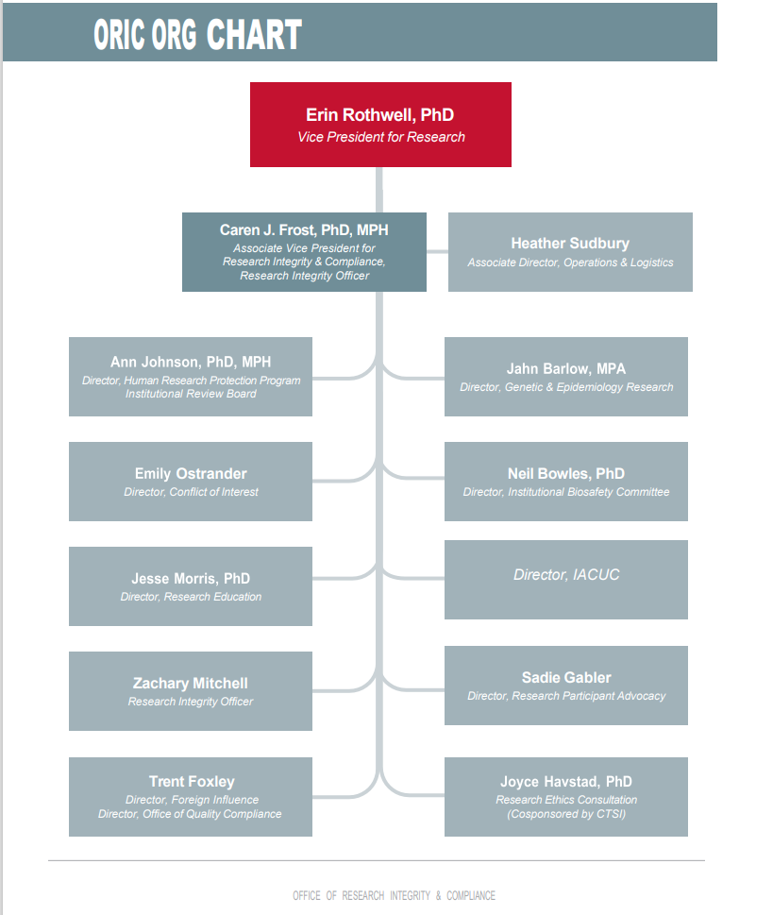
ORIC Units
ORIC Annual Report: oric-annual-report-2023.pdf (utah.edu)

Slide 5

Federal Landscape Changes
Steering Committee on DSMP tools and monitoring
  Developing processes for monitoring plans once people are funded
  Using the DSM tool (available through the Marriott Library) (DMPTool)
    Data librarians
  Connecting The Hive for storing data (Hive (utah.edu)) and CHPC for storing data (Center for High Performance Computing - The University of Utah)
Responsible (& Ethical) Conduct of Research Training
  NIH (2022) [NOT-OD-22-055: FY 2022 Updated Guidance: Requirement for Instruction in the Responsible Conduct of Research (nih.gov)]
    11 topics areas
  NSF (revisions for 2024)

Slide 6
Potential Federal Landscape Changes
U.S. Office of Research Integrity
  Revisions to research misconduct processes
  Refined definition of research integrity
NIH & NSF Expectations about AI Use
  Guidelines for using AI (Notice to research community: Use of generative artificial intelligence technology in the NSF merit review process | NSF - National Science Foundation)
LabArchives
  Working with the Marriott Library on accessing and using LabArchives (Home - LabArchives - ULibraries Research Guides at University of Utah)
  Federal discussions about required use of electronic notebooks (NIH RCR training)
Task Force on Repatriation of Materials, Artifacts, and Digital Items
  Drafting policy for UU to establish a holistic process for returning physical and digital artifacts, data, materials, and remains to Indigenous groups

Slide 7

UU Forthcoming Policies and Policy Updates
General Research Policy on Sponsored Research (with OSP)
New guidelines on managing unprofessional behaviors in the research environment
New policy on data stewardship & management
  Includes connection to NIH data management & sharing plans
New policy on foreign influence

Slide 8
ORIC Events
Enhancing Research Mentoring Symposium
  Alumni House on Tuesday, March 12, 2024 from 8:30 a.m. to 3:00 p.m.
      https://www.signupgenius.com/go/805054AA9A92AA64-46315763-university
AI Ethics Forum
  Connecting with Responsible AI Initiative from VPR’s Office
  Connecting with DATASET Initiative & Digital Humanities Utah
  Location & Date: TBD

Slide 9


Emily Ostrander, Director
coi.utah.edu
801-587-3232

Slide 10
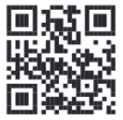
Conflict of Interest Office
A financial conflict of interest exists when an individual, or the institution, has financial interests that have the potential to influence, or bias, their responsibilities to the University.
Our mission is to support innovation and research at the University of Utah. Effective management of financial conflicts of interest in research, scholarly and educational activity, and business transactions protects the integrity and scientific merit of our community.
Disclosure is the key mechanism to bring potential financial conflicts of interest to light for evaluation and possible oversight.
File your financial disclosure online in the University’s Business Relationship Reporting system at http://BRR.utah.edu (or search for BRR in Campus Information Systems).

Slide 11
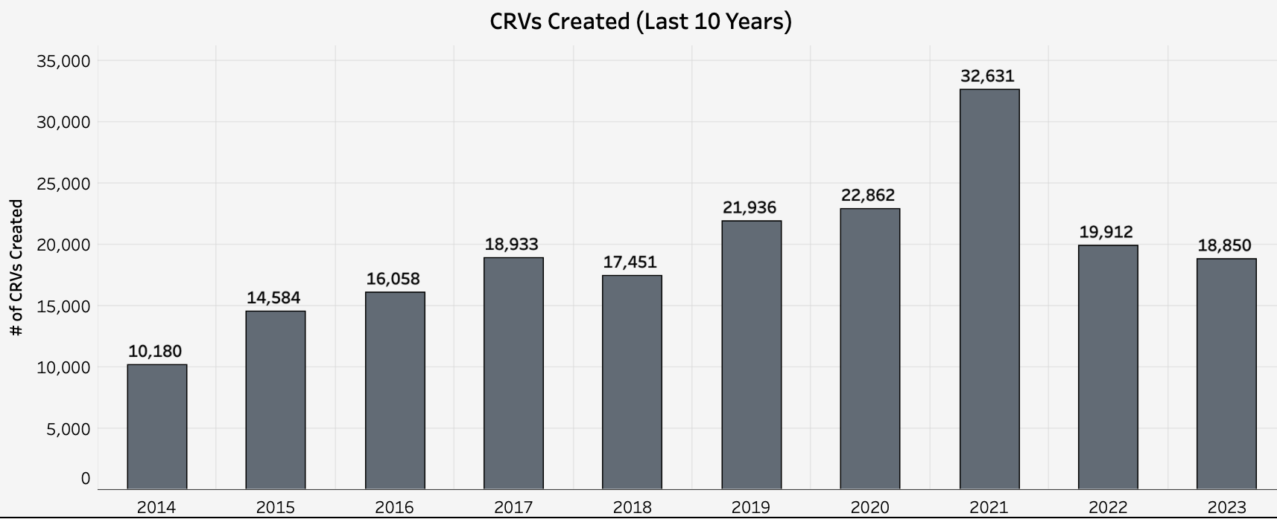
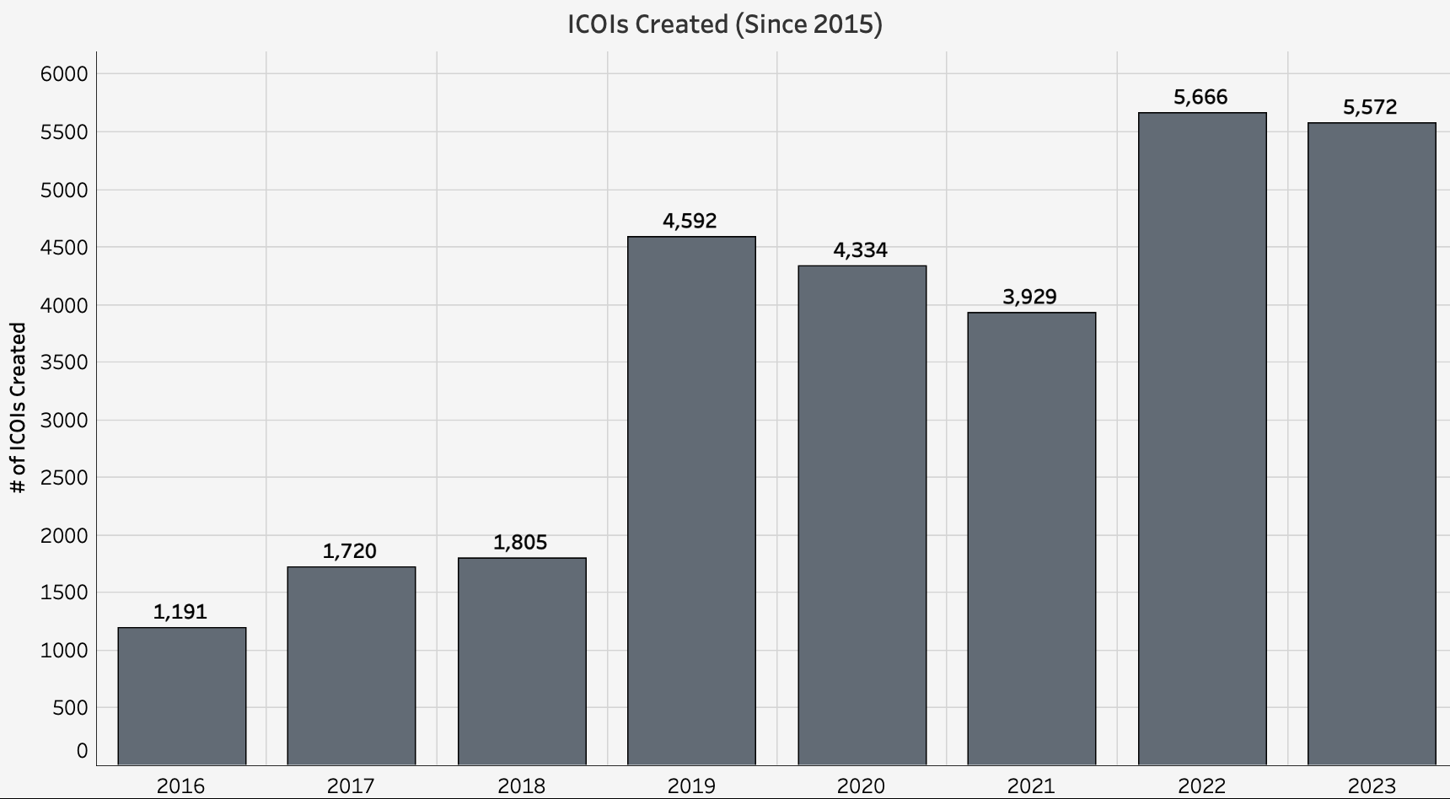
COI 2023 Highlights
COI Office staff presented at national conferences representing the University of Utah:
Society of Research Administrators International iSeries 2023 Virtual Conference
Public Responsibility in Medicine and Research (PRIM&R)
METRICS
Individual COI Reviews (for research) Institutional COI Reviews

Slide 12

COI Updates and Notifications
2023 federal policy changes:
  National Science Foundation (NSF) Grantee Standards effective January 30, 2023
  National Aeronautics and Space Administration (NASA) effective December 1, 2023
  These include a new requirement to disclose venture and capital financing when related.
2022 University of Utah Individual Financial Conflict of Interest Policy 1-006 revisions:
  Revisions to incorporate updates in federal policy (new Department of Energy policy similar to existing PHS regulation)
Compliance efforts are increasing:
  Analyzing Publicly Available Datasets to Identify and Reconcile Gaps in Financial Conflict of Interest Disclosure
  Keep your financial disclosure accurate and up-to-date!

Slide 13
COI & Other University Policies
What is the process for employees to obtain approval for external financial relationships?
Conflicts of Interest (COI Office)
Individual Financial Conflict of Interest Policy 1-006
Institutional Conflict of Interest Policy 7-006
Conflicts of Commitment
Policy 5-204: Remunerative Consultation and Other Employment Activities
Supplemental Rule 1-006: Health Sciences Industry Relations Policy
  UUHC Policy: Conflict of Interest (Annual Attestation)
  UUHC Policy: Vendor Gifts Policy and other Vendor Policies
  UUHC Policy: Graduate Medical Education Industry Relations Policy
Policy 8-001: Medical Practice Plan for the University of Utah School of Medicine Full-Time Faculty
Conflicts in the Workplace
Policy 1-020: Required Professional Boundaries in Relationships
Policy 3-111: Contracts with Individuals and Other Legal Entities
Policy 6-316: Code of Faculty Rights and Responsibilities

Slide 14

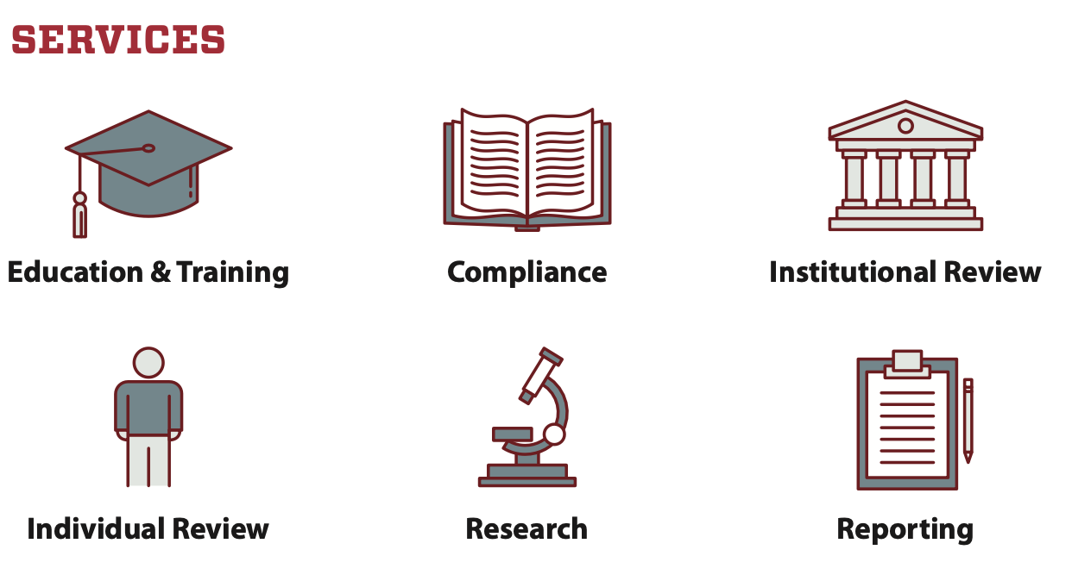
COI Contact Information

Slide 15

Trent Foxley, Director
foreigninfluence.utah.edu
trent.foxley@hsc.utah.edu

Slide 16

Office of Foreign Influence
Services
Our mission is to address the risk of potential undue foreign influence associated with the University’s ongoing commitment to advancing
responsible research and discovery on the local, national, and global levels.
Screening/Review
Foreign Influence Education
International Travel Guidance
Foreign Influence Consults

Slide 17

Office of Foreign Influence
Disclosure/Reporting
What
Where
Foreign funding
Unfunded (in-kind) resources
Unfunded services of visiting scholars, employees, students
Participation in foreign government entity and foreign government talent recruitment programs
Foreign sponsored travel
Honoraria or stipends
Funded or unfunded services
Foreign Collaborations
Unauthorized foreign national access to U.S. government information, equipment, and/or technologies
Business Relationship Reporting (BRR) system (http://brr.utah.edu)
Updated at least annually
Updated within 30 days of establishing a relationship with a foreign entity/individual

Slide 18
OFI Metrics

Slide 19




Office of Foreign Influence
Updates and Notifications
Reporting to funding agencies
  Common Forms
Defending Education and Ending Rogue Regimes Engaging in Nefarious Transactions (DETERRENT) Act
  Impact of proposal
NSPM - 33
  Directives to meet requirements
International Travel Guidance
  https://foreigninfluence.utah.edu/international-travel-guidance.php

Slide 20



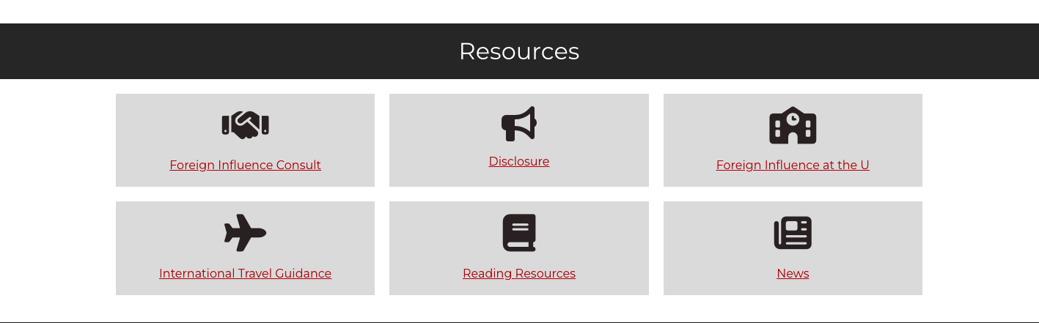
Office of Foreign Influence
Contact Information
Website: foreigninfluence.utah.edu
Email: foreigninfluence@utah.edu
Phone: 801-213-7092

Slide 21

Neil Bowles, PhD
Director
Biosafety Officer
Neil.Bowles@ehs.utah.edu
801-585-9325

Slide 22
Institutional Biosafety Committee (IBC)
Neil E. Bowles, Ph.D.
IBC Director and University of Utah Biosafety Officer
Mission
To support safe, secure and responsible research with biological materials by providing technical assistance and oversight to assure the safety of researchers, research materials, the environment and the public

Slide 23
Institutional Biosafety Committee (IBC)
IBC Registrations submitted in BioRAFT (lab) or ERICA (clinical)
  Convened Committee Review
    Non-Exempt work with recombinant or synthetic nucleic acid molecules (per NIH Guidelines)
    Human and Animal Pathogens
    Acute Biological Toxins
    Amendments involving a revised or a new risk assessment
  Administrative Review
    Exempt work with recombinant or synthetic nucleic acid molecules
    Human samples and cell lines (OSHA compliance)
    Amendments involving no changes to the risk assessment (e.g. addition of personnel)
Ensure Investigators have complete Standard Operating Procedures and Biosafety Manuals
  NIH and CDC requirements
Ensure Labs are periodically inspected (Environmental Health and Safety (EHS))
Ensure personnel are adequately trained on risks, engineering and administrative controls, use of personal protective equipment, and emergency procedures

Slide 24
IBC Registrations:
  Convened Committee: 111 in 2023 (99 BioRAFT, 12 ERICA)
    122 in 2022
    Turnaround times:
      BioRAFT: 14.2 days
      ERICA: 8.7 days
  Administrative Review: 123 (44 in BioRAFT, 79 in ERICA)
    100 in 2022
    Turnaround times:
      Most less than 2 days (11 3-8 days)
Lab Inspections:
  BSL-1: 390 (396 in 2022)
  BSL-2 or higher: 171 (128 in 2022)
Biosafety Classes
  82 classes attended by 1849 trainees (61 classes and 1626 trainees in 2022)
  Online classes: 2 classes completed by 170 trainees

Slide 25
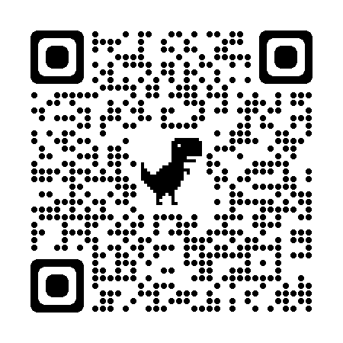
Institutional Biosafety Committee (IBC)
Updates and Notifications
Moving more classes online (January 2024?)
  Developing new classes for non-laboratory staff
Update to human gene transfer registrations in ERICA (January 2024)
Opening of the BSL-3 facility in EEJ (early 2024?)
  BSL-3 training classes
  BSL-3 Biosafety Manual/Standard Operating Procedures for the EEJ facility
  New BSL-3 spaces
Contact: Biosafety@EHS.Utah.Edu
Website: IBC.Utah.Edu

Slide 26

Ann Johnson, PhD, MPH, CIP
Director
Annie Risenmay, MPA, CIP
Associate Director
irb.utah.edu
801-581-3655

Slide 27
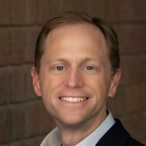
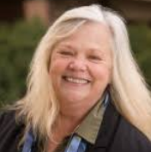
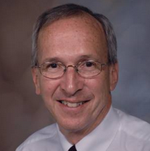

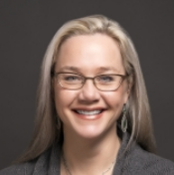
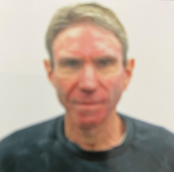
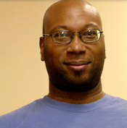
Institutional Review Board (IRB)
Mark Eliason, MD, Chair
Professor, Dermatology
Ruth Gerritsen-McKane, PhD, Chair
Professor Emeritus, College of Social Work
Richard Lemons, MD, PhD, Chair
Professor/Medical Director/Chief, Pediatric Hematology/Oncology
Kathy Peterson, MD, MSCI, Vice Chair
Professor, Gastroenterology
Jerry Treiman, MD, Vice Chair
Professor of Surgery; VASLCHC
Paul White, PhD, Vice Chair
Associate Professor, Psychology
Ann Johnson, Director
Phone: (385)419-0712
Email: ann.johnson@hsc.utah.edu
Annie Risenmay, Associate Director
Phone: (801)587-9137
Email: annie.risenmay@hsc.utah.edu

Slide 28
2023 IRB Accomplishments
2024 IRB Updates & Notifications
We have actively pursued Justice, Equity, Diversity & Inclusion (JEDI) work by continuing to develop a panel of community members, Panel C. This group helps inform IRB practices and policy from a community perspective.
We implemented a new policy that will make research more inclusive of individuals who speak Spanish, requiring most new prospective studies to have translated materials for these potential participants.
We continue requiring all studies without an expiration date to provide information about study status annually via our HRPP Progress Update application.
Please see our Publications and Posters page for updates on our involvement in the IRB community.
April 1, 2024: The IRB will require all previously approved, prospective studies with participant interaction conducted by UU investigators within Utah to adopt the Spanish-speaking inclusion policy.
We intend to engage our Panel C members in health literacy training, focusing on participant-facing documents and concise summaries in consent forms.
Plans are in the works for a second Utah Community Research Ethics (UCRE) conference. Watch for announcements and registration information.

Slide 29

Sadie Gabler, Director
Participant.advocate@hsc.utah.edu.
801-581-3803

Slide 30






Office of Research Participant Advocacy
SERVICES PROVIDED
Language access services for non-English speaking participants and researchers, with in-house certified Spanish translators and interpreters.
Health literacy training, evaluation, and support to aid in developing accessible documents and facilitate successful recruitment and retention.
Multiple REd and departmental trainings.
Participant liaison/intermediary to aid in concerns raised during participation.
  Recruitment Resources:
  StudiesForYou (previously StudyLocator): https://studiesforyou.utah.edu
  ResearchMatch: https://www.researchmatch.org

Slide 31

2023 Accomplishments/Highlights:
3 New Languages Added to the IRB Short Form Translation Library:
  Serbian (Cyrillic Script),
  Japanese and
  Croatian.
  Total of 60 languages available for enrolling participants with the use of translated Short forms.
Redesign of StudyLocator and renamed to StudiesForYou.
Completion of StudiesForYou sister site in Spanish.

Slide 32
Translation Language Access Numbers
2020-2022 - 68% increase
Word count increase from 2020 (971, 903) to 2022 up by 60%, with over 1.5m words translated in 2022.
2022* was exceptionally high due to a few large SIRB multi-site trials.
Anticipate 2024 will continue to trend up based on VPR support, new IRB policy, and Title VI adherence.
1,562,345
1,279,856
993,283
971,903
w/ Word Ct. incl.

Slide 33

Looking Ahead in 2024
Office of Equal Opportunity (OEO) received complaint 12/2023 regarding violation of Title VI of the Civil Rights Act of 1964 aka Nondiscrimination Act regarding (LEP) and research study opportunity for non-English speaking participants.
IRB Policy April 1, 2024 “All previously approved, prospective studies with participant interaction conducted by University of Utah investigators within the state of Utah that are open to enrollment and submit for continuing review after April 1, 2024, must adhere to the new inclusion of Spanish speaking individuals to receive renewed IRB approval.” Policy: Including People Who Speak Spanish
Translation and Interpretation Requests integration with ERICA to streamline the process and increase efficiency.
Anticipate another record setting year in language access utilization along with an increase in participant concerns in part due to the mental health crisis and financial challenges many are experiencing.

Slide 34
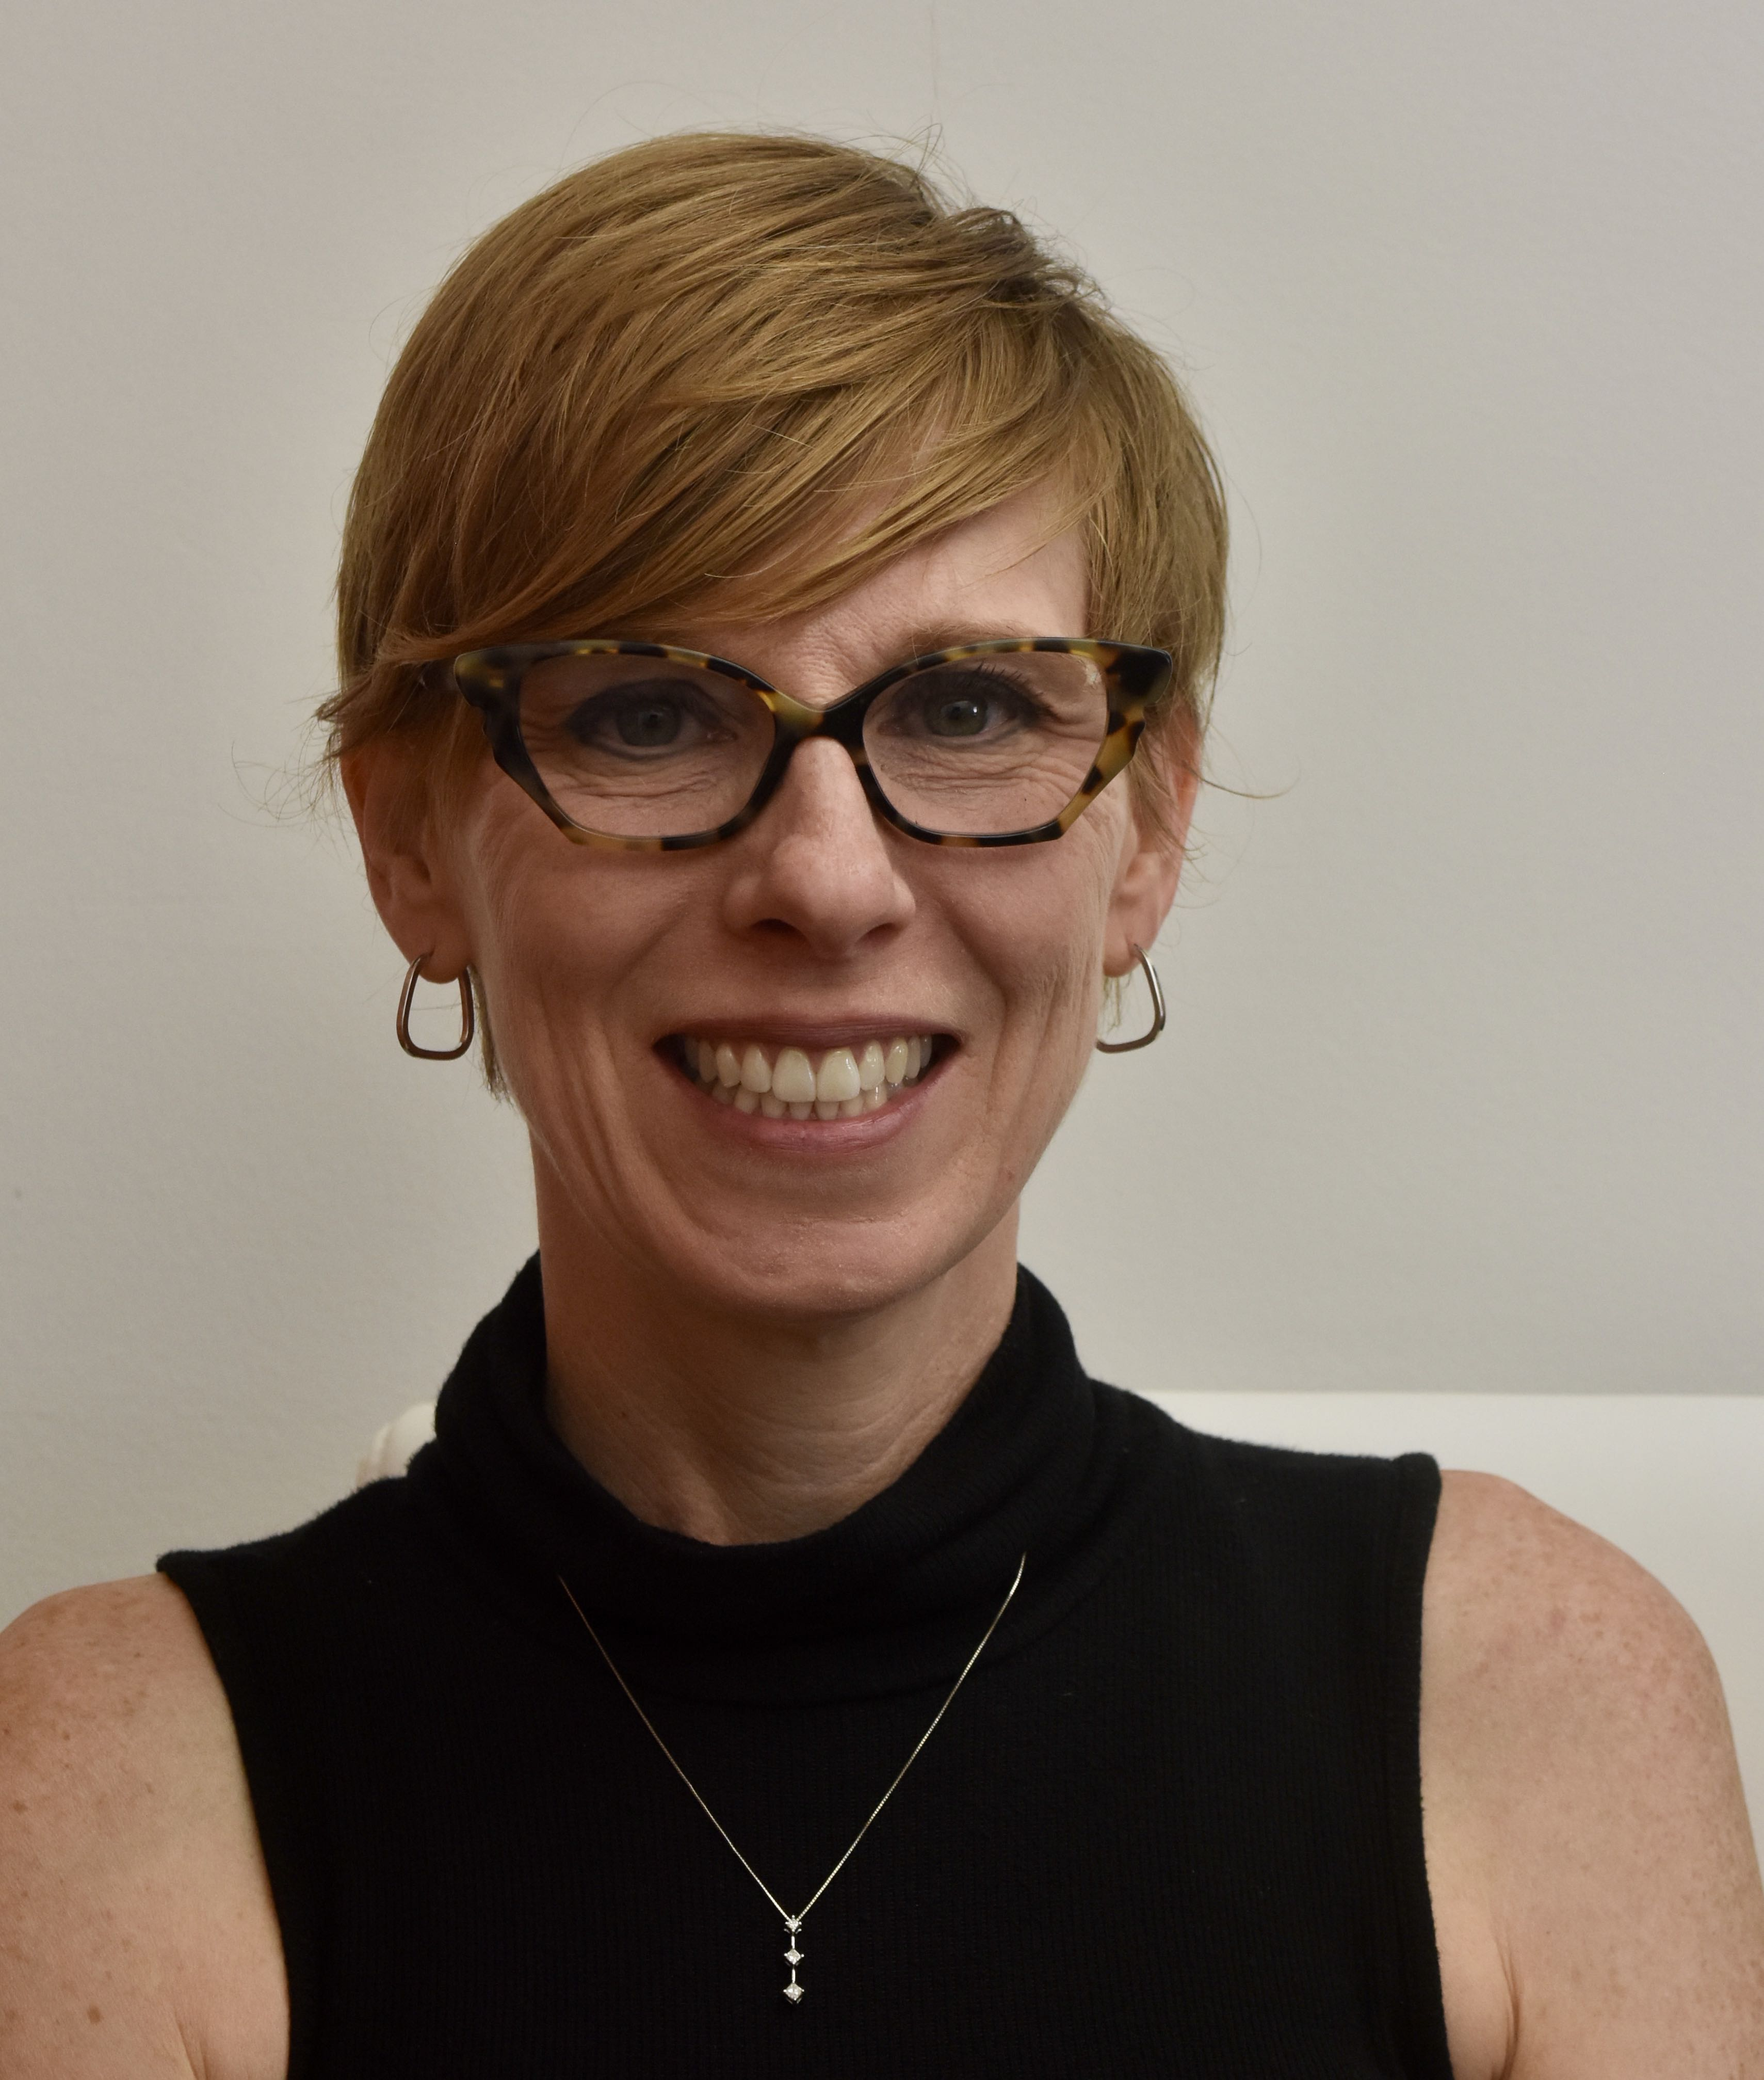
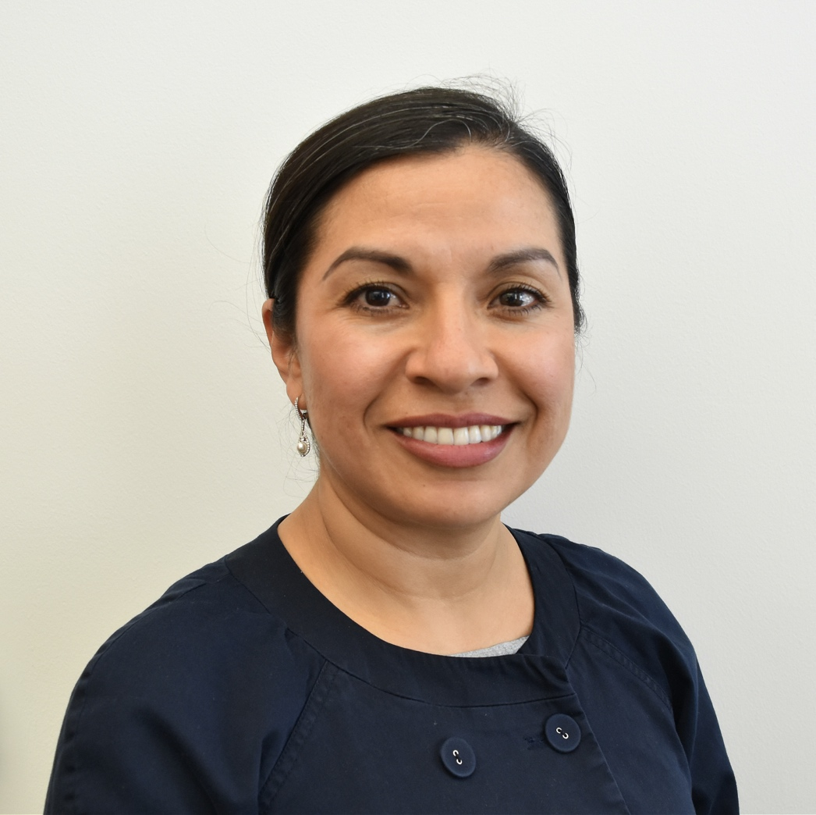
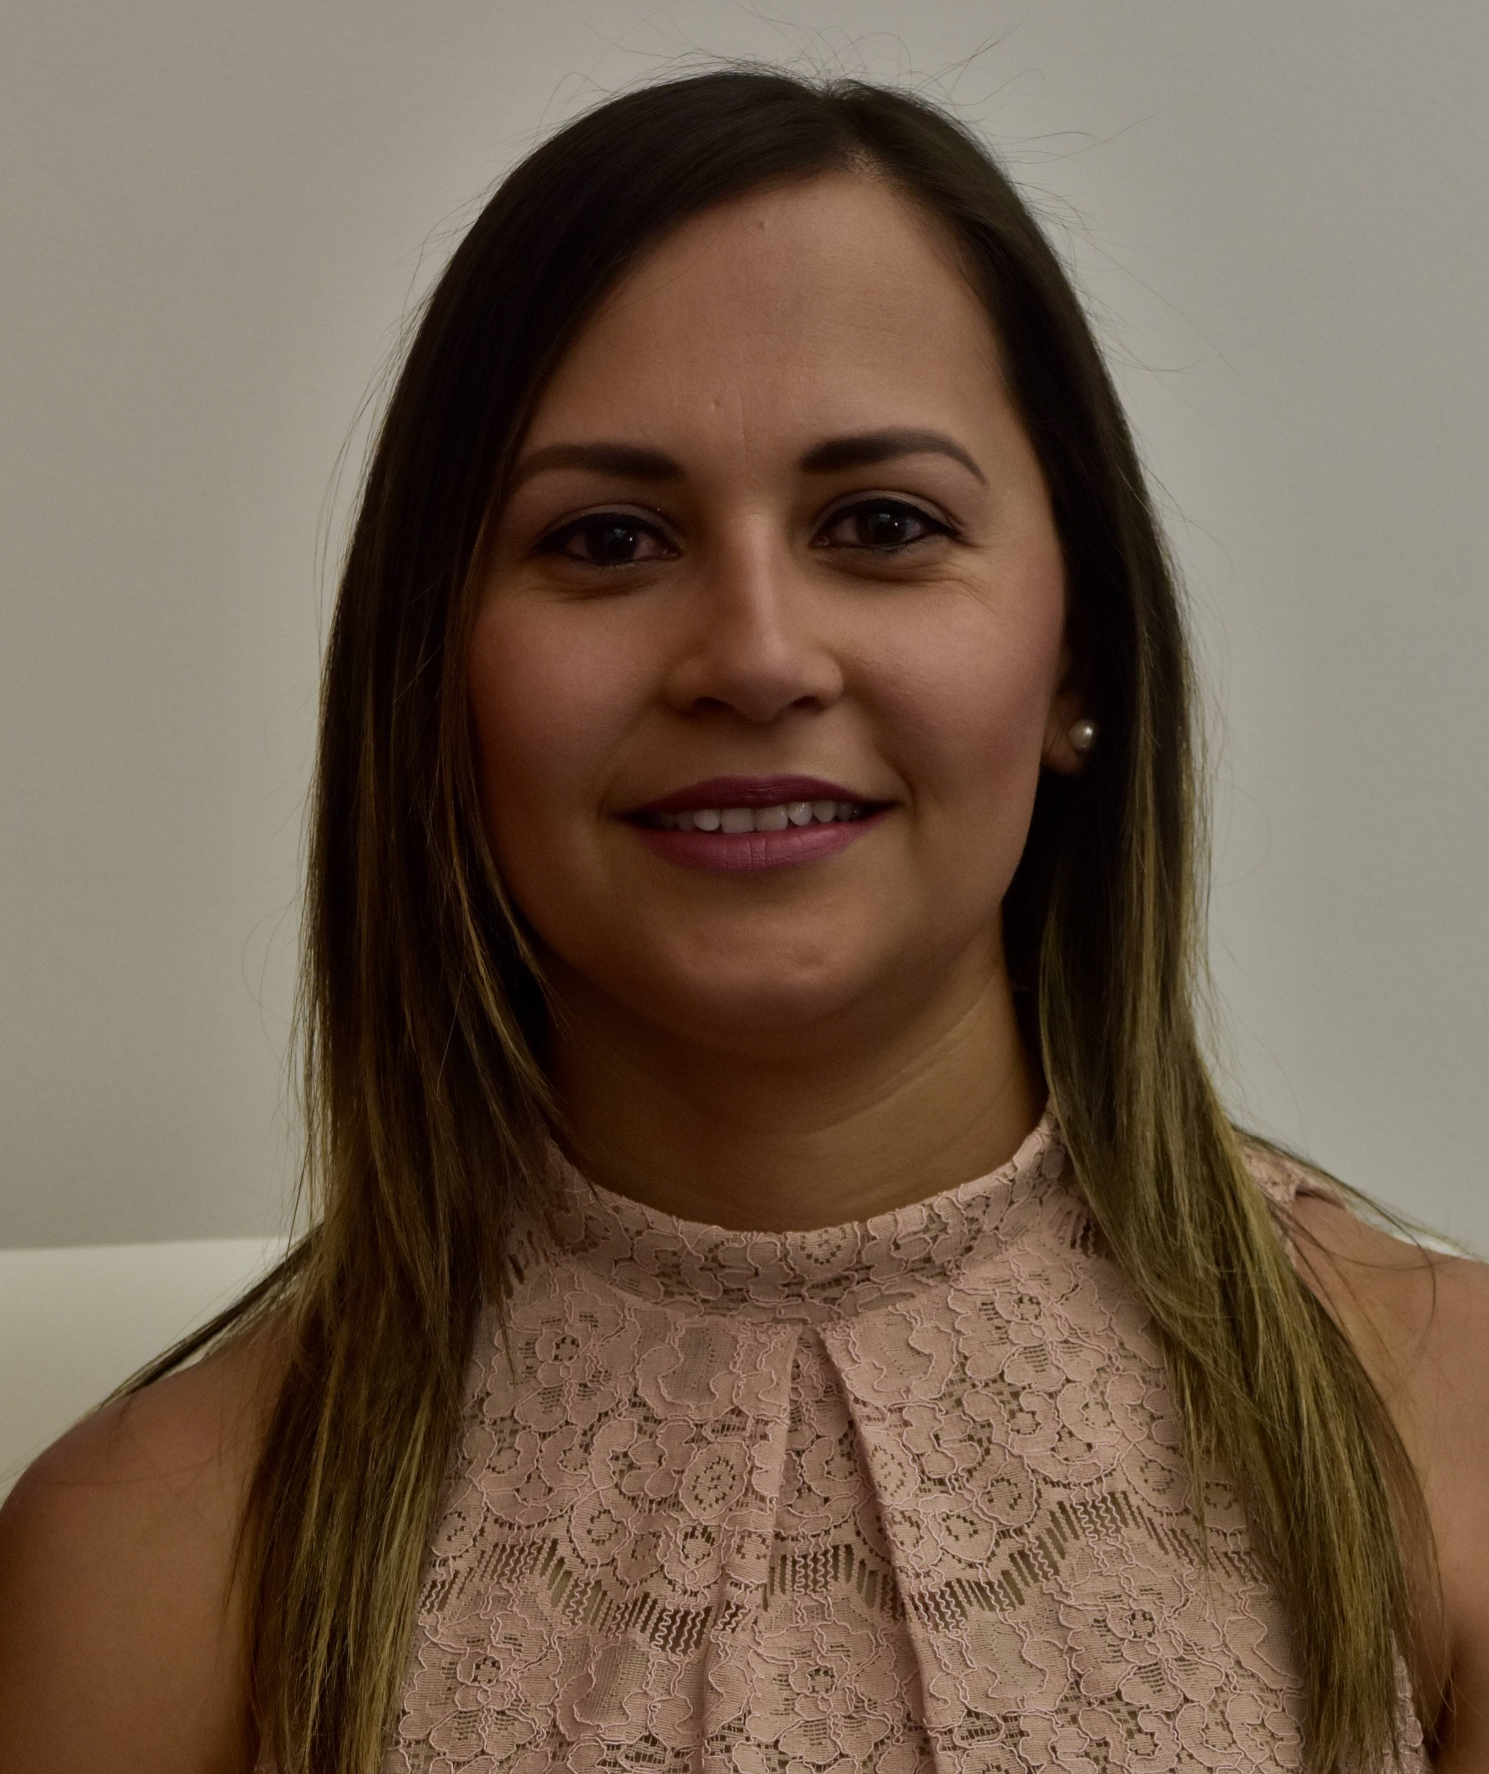
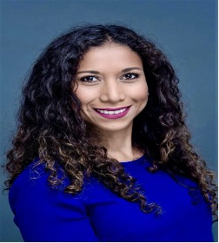

Office of Research Participant Advocacy Team
Sadie Gabler
Director
Amanda Barrios
Sr Program Manager
Spanish Translator/Interpreter
Diana Cufino
Admin Program Manager
Contact Information
ORPA Office: 801.581.3803
Participant.advocate@hsc.Utah.edu
Language Access Services
801.585.6745
Research.translation@hsc.Utah.edu
https://rpa.utah.edu
Ana Corona
Spanish Translator/Interpreter
Taanisha Rhone
Admin Assistant

Slide 35

Trent Foxley, Director
oqc.utah.edu
801-581-7170

Slide 36

Office of Quality Compliance (OQC)
Our mission is to facilitate ethical, efficient and high-quality research, and protect overall data integrity.
Reviews
Resources
Self-Assessment Reviews
Research Climate Assessments
Best Practice Reviews
OQC Toolkit
Guidance Documents
Research Quality Compliance Network (RQCN)
University-wide Clinical Research SOPs
ClinicalTrials.gov

Slide 37
OQC Metrics
The OQC provides guidance,
education
and resources
to research teams and scholars across the University to promote responsible conduct of research.

Slide 38




Office of Quality Compliance (OQC)
Updates and Notifications
ClinicalTrials.gov
  Pre-Notice of Noncompliance
Self-Assessments
  “Check Yourself”
FDA Audits
  Notification, preparation and assistance
  oqc@utah.edu
Join the RQCN
https://www.lists.utah.edu/wws/subscribe/rqcn?previous_action=info

Slide 39
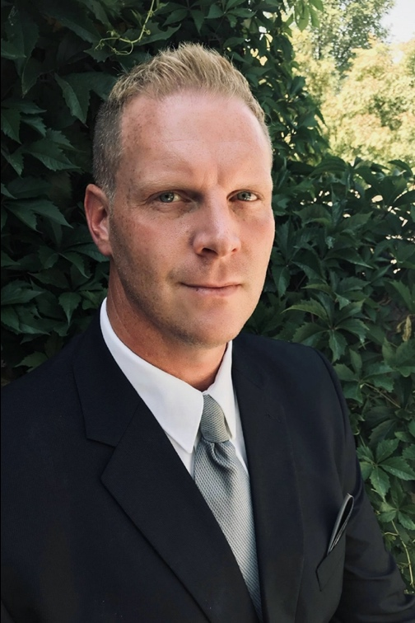

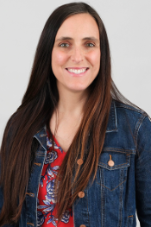
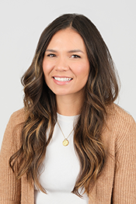

Office of Quality Compliance (OQC)
Contact Information
Website: oqc.utah.edu
Email: oqc@utah.edu
Phone: 801-213-7092
OQC Team
Trent Foxley
Director
Harley Lennon
Research Compliance Associate
Alisa Rushton
Research Compliance Associate
Frances Sebahar
Research Compliance Associate
Taanisha Rhone
Administrative Assistant

Slide 40

Jesse Morris, PhD
Director
education.research.utah.edu
researcheducation@utah.edu

Slide 41

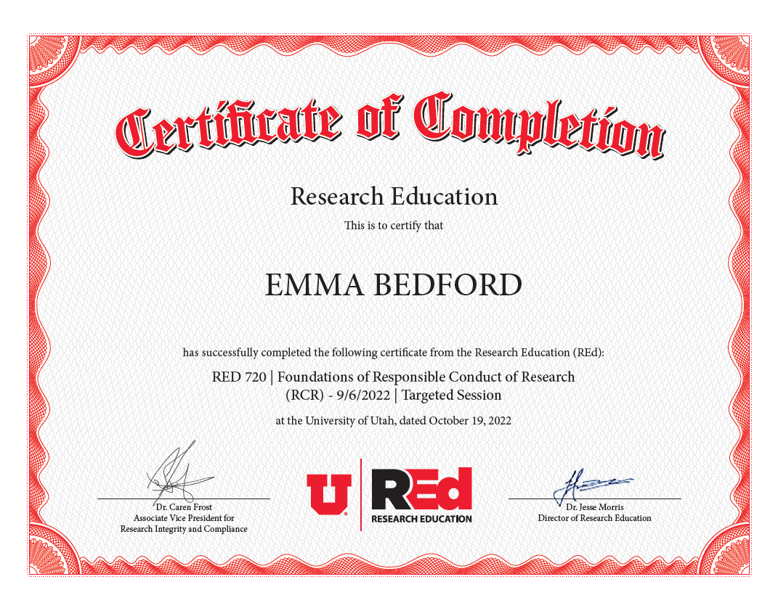
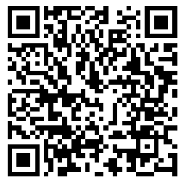
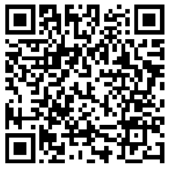
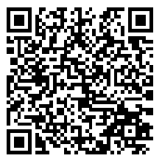
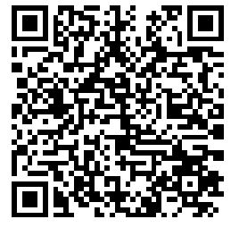
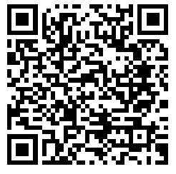
Research Education (REd)
Contact: Dr. Jesse Morris
Director of REd
jesse.morris@utah.edu
The Office of Research Education (REd) provides “comprehensive training and learning opportunities and resources for faculty, students and staff engaged in responsible conduct of research at the University of Utah.”
REd Certificates
Responsible Conduct of Research – Faculty/Staff
Responsible Conduct of Research – Students
Research Mentoring
Finance and Budget Management
Compliance in Research Activities

Slide 42
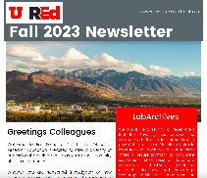
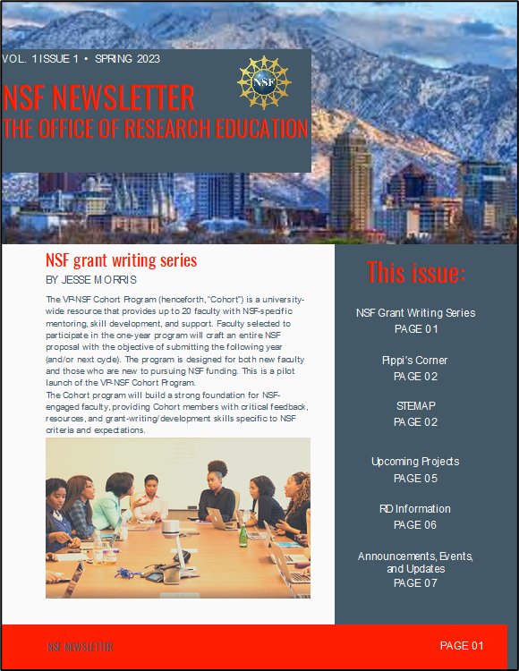


2023 Highlights
Offered 75 Unique Classes to >1300 U of Utah participants
Launched training opportunities to address new agency requirements from NSF
Doubled Research Mentoring course offerings
Expanded communications through new listserv, social media, and newsletters

Slide 43

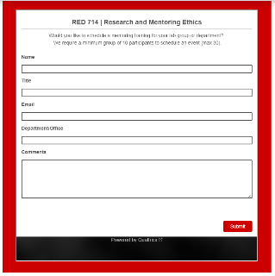
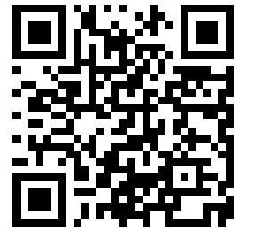
Updates and Notifications
Starting in Summer 2024 REd begin offering research education
content beyond the University of Utah community
Data Management Certificate will relaunch in 2024 to address new
requirements from NIH
New course scheduling options to provide additional flexibility
Contact: Dr. Jesse Morris
Director of REd
jesse.morris@utah.edu
https://education.research.utah.edu/

Slide 44

Jahn Barlow, Director
rge.utah.edu
801-581-6351

Slide 45
Utah Resource for Genetic and Epidemiologic Research (RGE)
Created by Executive Order of the Governor of Utah (1982, 1984)
Data resource for “the collection, storage, study, and dissemination of medical and related information” for “the purpose of reducing morbidity or mortality, or for the purpose of evaluating and improving the quality of hospital and medical care.”
  Review and approve research projects requesting access to the Utah Population Database (UPDB), All Payer Claims Database (APCD) and Utah Cancer Registry (UCR)
  Legal agreements with other institutions who contribute data
  Regulatory oversight and compliance for projects using the data
  Policies and procedures for data access and use https://rge.utah.edu/policies.php

Slide 46
Data Sources
Family Relations
UPDB
(Person)
Marriage & Divorce
UDHHS
Birth & Death
Driver License
Voter Reg & US Census
Disease Registries
UDHHS Healthcare Facilities Data
University of Utah Health
EDW
UDHHS
All Payer Claims Data
Intermountain Health
EDW
https://uofuhealth.utah.edu/huntsman/utah-population-database/data

Slide 47
2023 Highlights
Updated RGE Policies and Procedures
  Data Security
  Data Retention
  Data Disposition
  Contacting potential research participants
Reviewed the HIPAA Covered Entity Status of the Utah Population Database.
Completed the 2023 Biennial Internal Security Audit for Driver License Data from the Department of Public Safety as required by the Utah State Legislature and submitted a report to the Transportation Interim Committee.

Slide 48
RGE
Updates and Notifications
State Legislature
  Expanded opt-out?
Utah Department of Health and Human Services (UDHHS)
  Begin drafting new agreements with the merged UDHHS
  Finalize the policy on transferring data to storage locations outside of the United States
  Finalize the policy on remote access to data from locations outside the United States
Explore options for expanding CMS Medicare data years available
Planning and initial design for a RGE Portal to facilitate more efficient data approval and access
  Platforms
  Integration with ERICA

Slide 49
RGE Contact Information
RGE Staff
Jahn Barlow, Director jahn.barlow@utah.edu
Jennifer West, Sr Research Manager Jennifer.A.West@utah.edu
Jared DeWitt, Sr Data Security Analyst RGESecurity@utah.edu
RGE Committee
Deb Neklason, Chair, deb.neklason@hci.utah.edu
Morgan Millar, Vice Chair, morgan.millar@hsc.utah.edu

Slide 50

Zachary Mitchell, Associate Director
researchintegrity@utah.edu
801-581-7170

Slide 51
Office of the Research Integrity Officer (ORIO)
Mission:
ensure integrity in all research activities throughout the research lifecycle;
promote the safe and respectful treatment of all individuals in research environments.
Responsibilities & Services:
  receiving allegations of research misconduct and managing the University process for addressing and resolving allegations (as defined in University Policy 7-001);
  receiving complaints and/or concerns of unprofessional behavior occurring in the research environment and facilitating resolution through collaboration/coordination with cognizant department chairs, college deans, faculty vice presidents, and other University offices;
  supporting the development of University policies related to all areas of research integrity;
  developing education and training regarding the responsible and professional conduct of research, detrimental and questionable research practices (DRPs and QRPs), and other critical topics related to research integrity/compliance.
Contact Methods:
  Email: Zachary.Mitchell@hsc.utah.edu and/or researchintegrity@utah.edu
  Phone: 801-581-7170
  Anonymous EthicsPoint Form: http://www.ethicspoint.com/

Slide 52
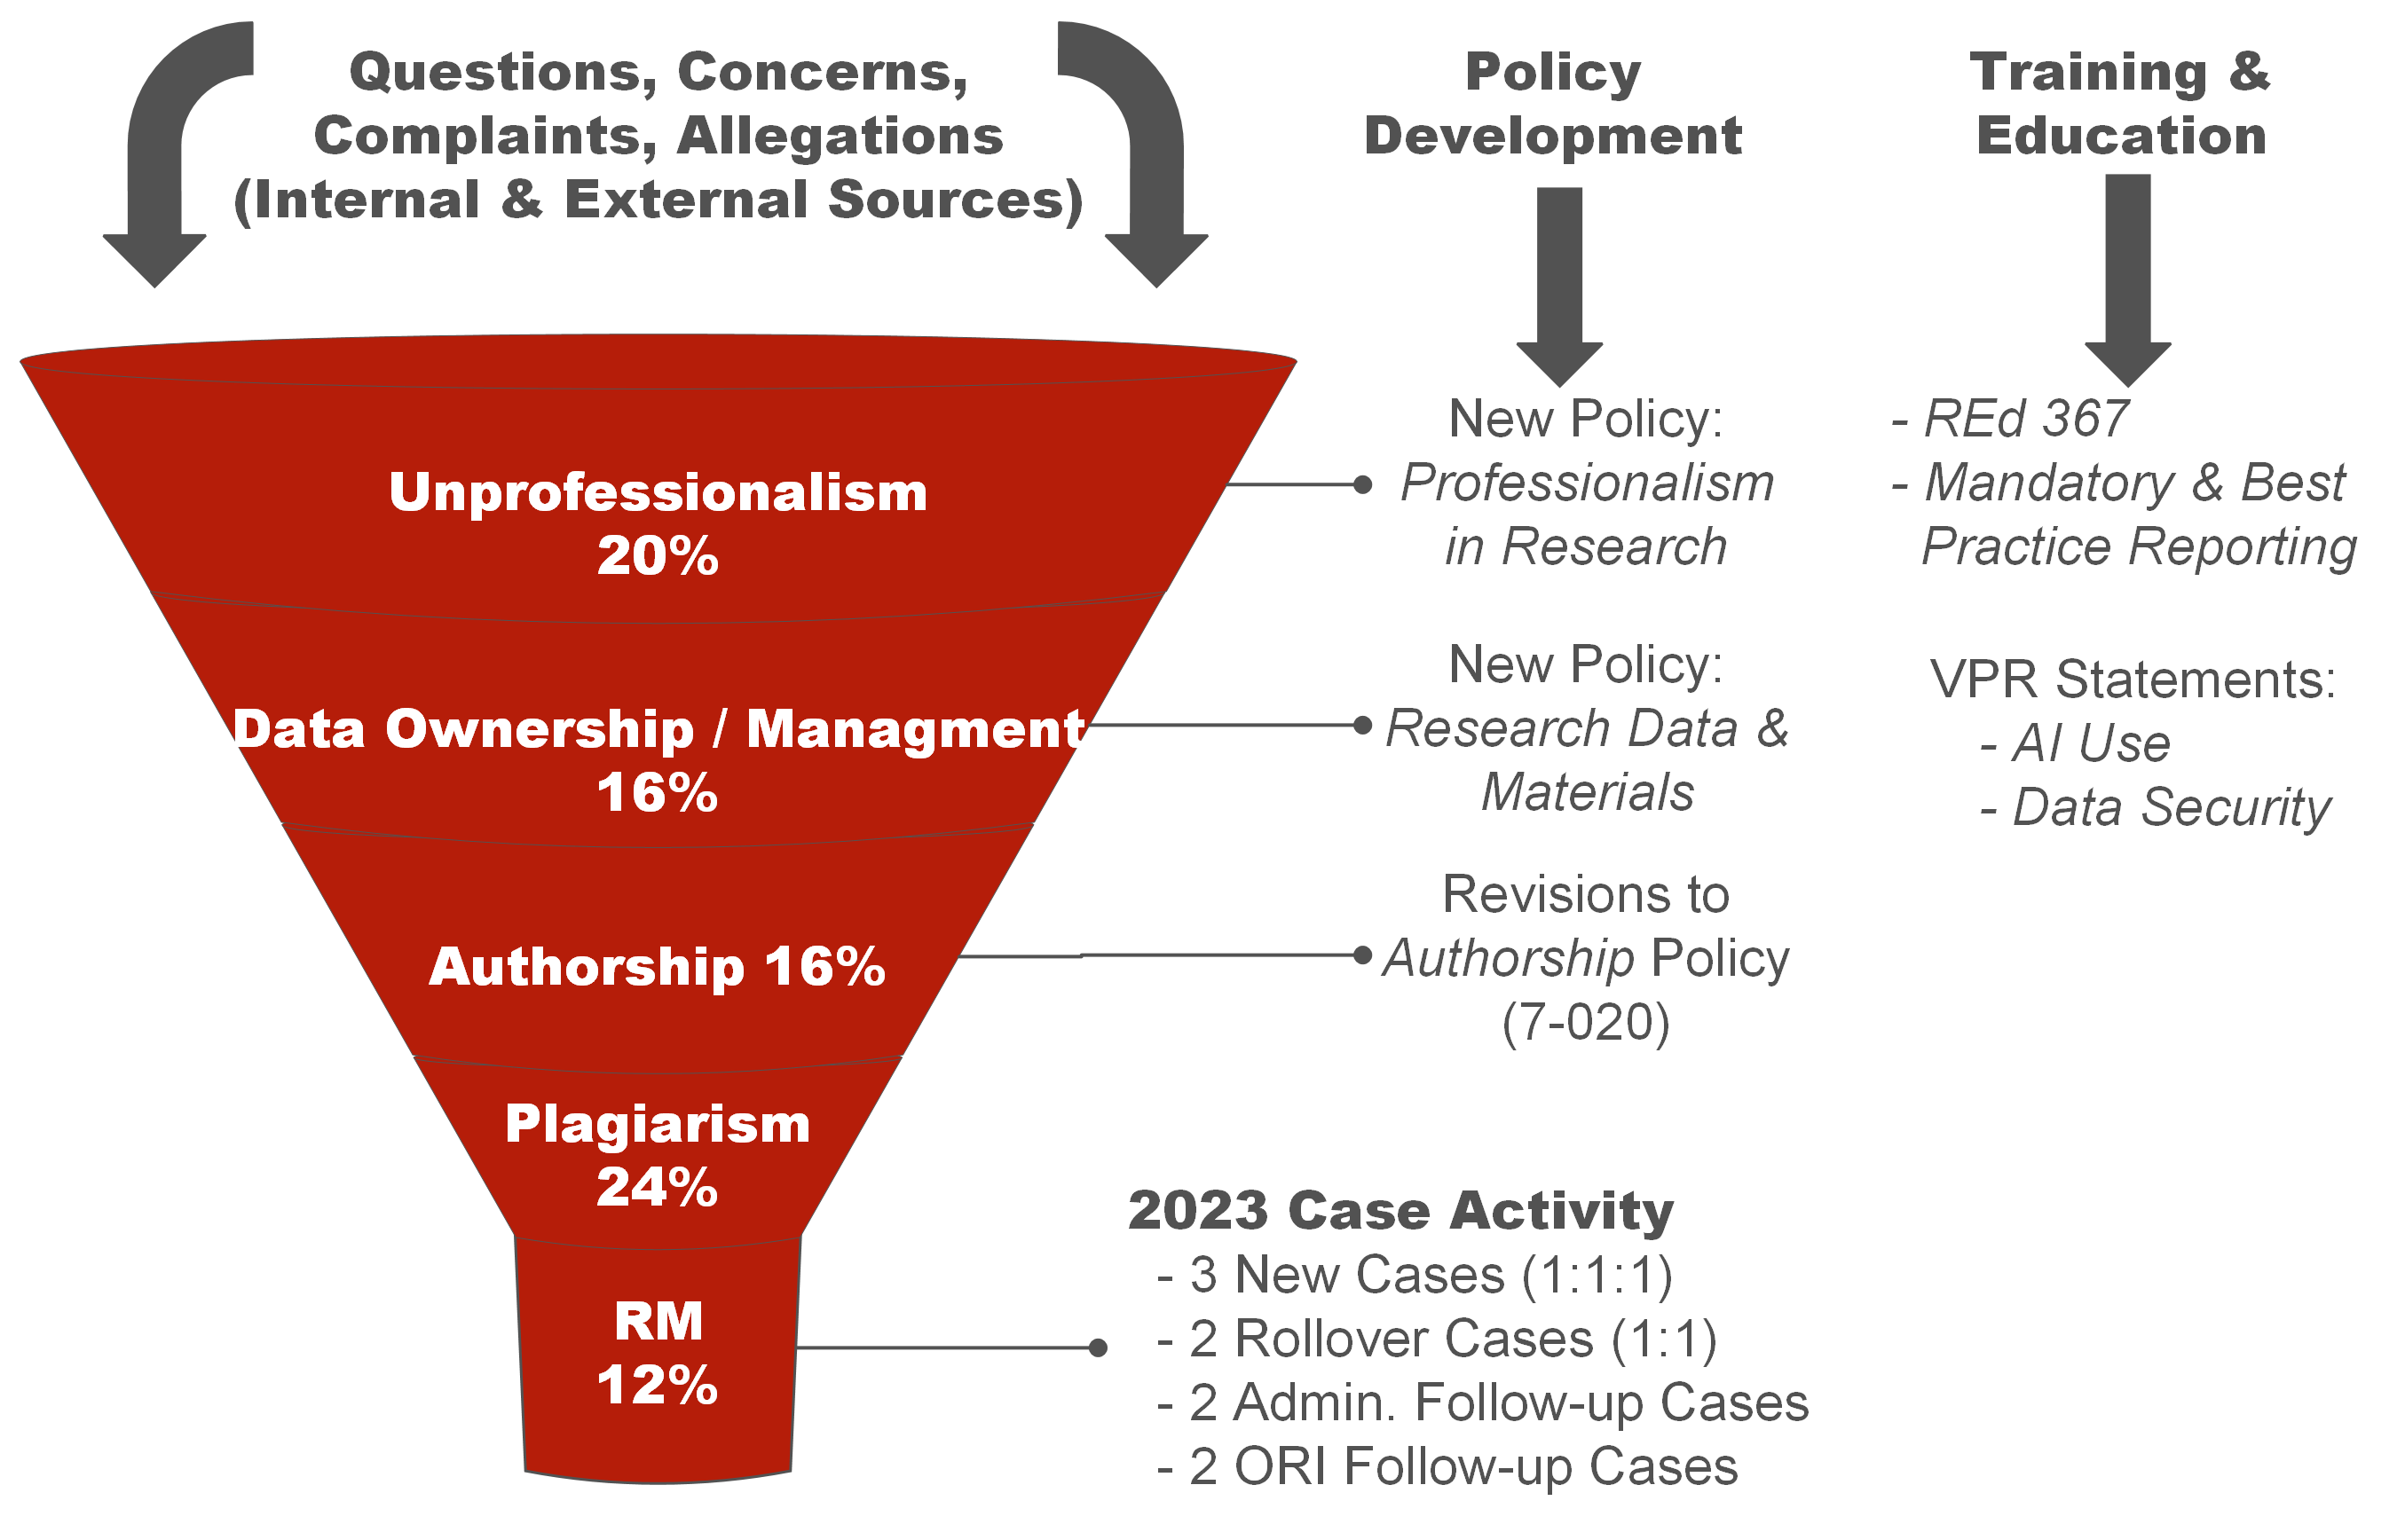

Slide 53
ORIO Updates and Notifications
Federally-Proposed Changes to Research Misconduct Regulations
October 6, 2023: Office for Research Integrity (ORI) published a Notice of Proposed Rulemaking (NPRM) to update the Public Health Service (PHS) Policies on Research Misconduct
This is the first revision to the PHS policy since the 2005 (42 CFR Part 93)
The NPRM has undergone extensive review locally and nationally
  The University of Utah has provided written comments/responses and added support to letters from national coalitions (i.e., ARIO, COGR, Ropes & Gray LLP)
Drafted revisions to the University’s Research Misconduct Policy, pending finalization, for incorporation in January 2025
Final rule expected Summer 2024

Slide 54

THANK YOU
https://integrity.research.utah.edu
(801) 581-7170

